Slide 1
Assignment 3
Group 7
Aditya Madhav Shinde
Jyotirmayee Mahanandia
Rachitha Dhanraj

Slide 2
Problem Statement
The main goal is to manage power supply efficiently for a given area:
Our problem statement is from the perspective of the electricity providers like National Grid. By predicting the electricity usage for the next year, the electricity providers can manage power supply for that particular region for working days and holidays.
Prediction of electricity usage over the next year for that area will help determine:
-The area with maximum usage of electricity during working days(Kwh)
-The area with maximum usage of electricity during holidays(Kwh)
The behavior of electricity consumption based on the day of the year ( Holiday or Working day) for all areas is analyzed by exploratory data analysis.

Slide 3
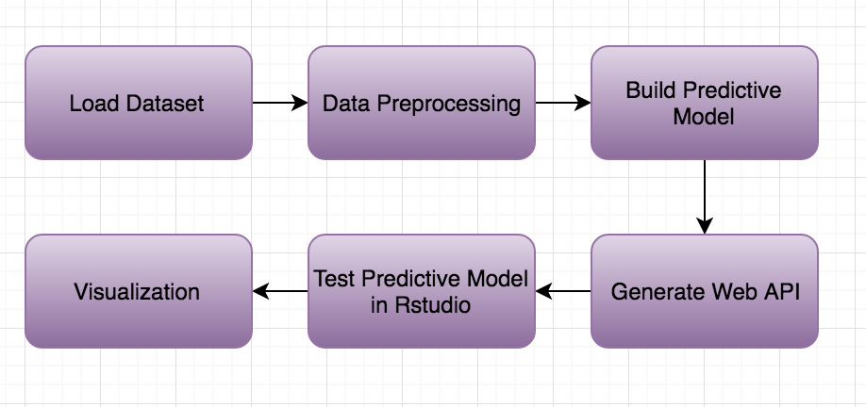
Activity Pipeline

Slide 4
Workflow Detail
Step 1: All the CSV files were merged according to area using R. The null values were removed using R.
Step 2: The prediction model was built for each area using Azure. The missing values were replaced with mean values. We used Boosted decision tree regression Model for the prediction.
Step 3: The prediction model was deployed and the web API key was used in R script to confirm the predicted values.
Step 4: Exploratory Data Analysis was performed using Power BI tool to study trends of the data.

Slide 5
Technical Specification
Data Preprocessing: Microsoft Azure Machine Learning and RStudio
Exploratory Data Analysis: Power BI tool
Build Predictive Model: Microsoft Azure Machine Learning.
Deploying Web Service: Microsoft Azure Machine Learning.

Slide 6
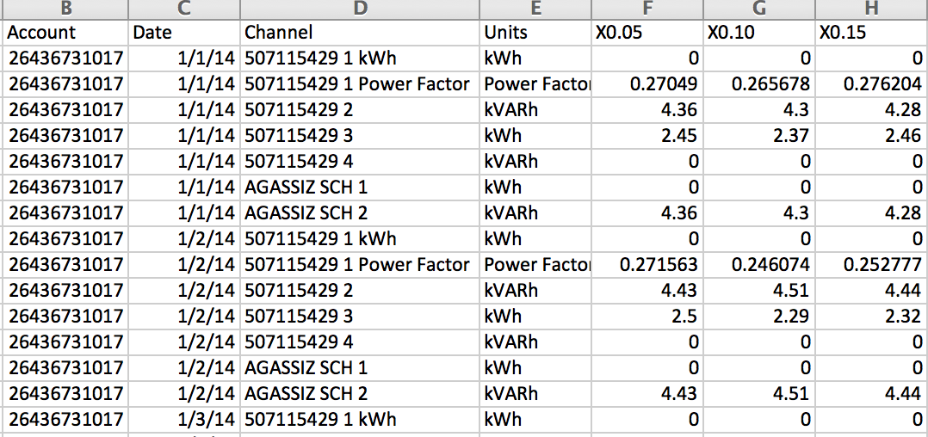
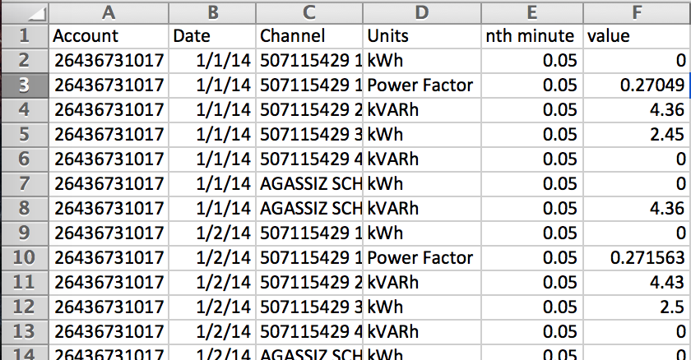
Dataset

Slide 7
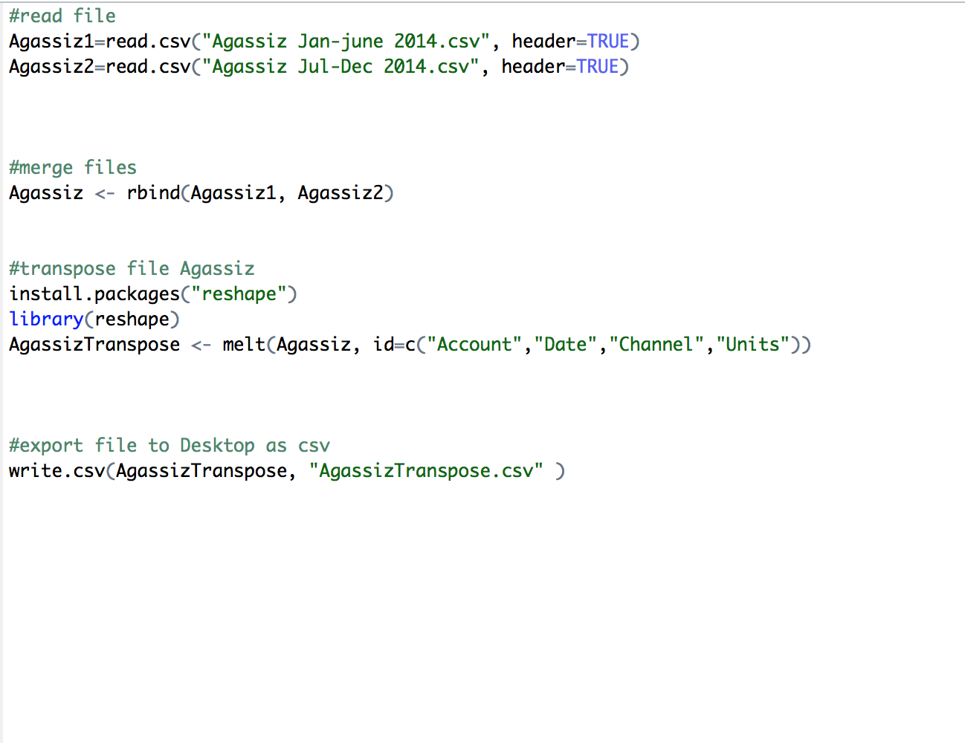
RStudio

Slide 8
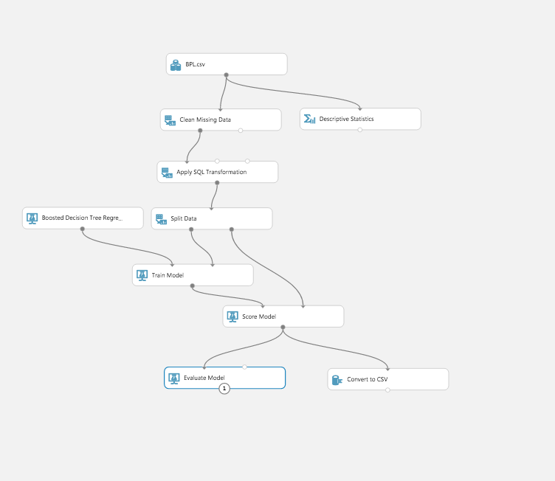
MS Azure ML Model

Slide 9
Metrics
Boosted Decision Tree Regression:
Coefficient of Determination(R-squared value)= 0.86
Linear Regression:
Coefficient of Determination(R-squared value)= 0.31
Neural Network:
Coefficient of Determination(R-squared value)= 0.36

Slide 10
THANK YOU!!!

